Slide 1
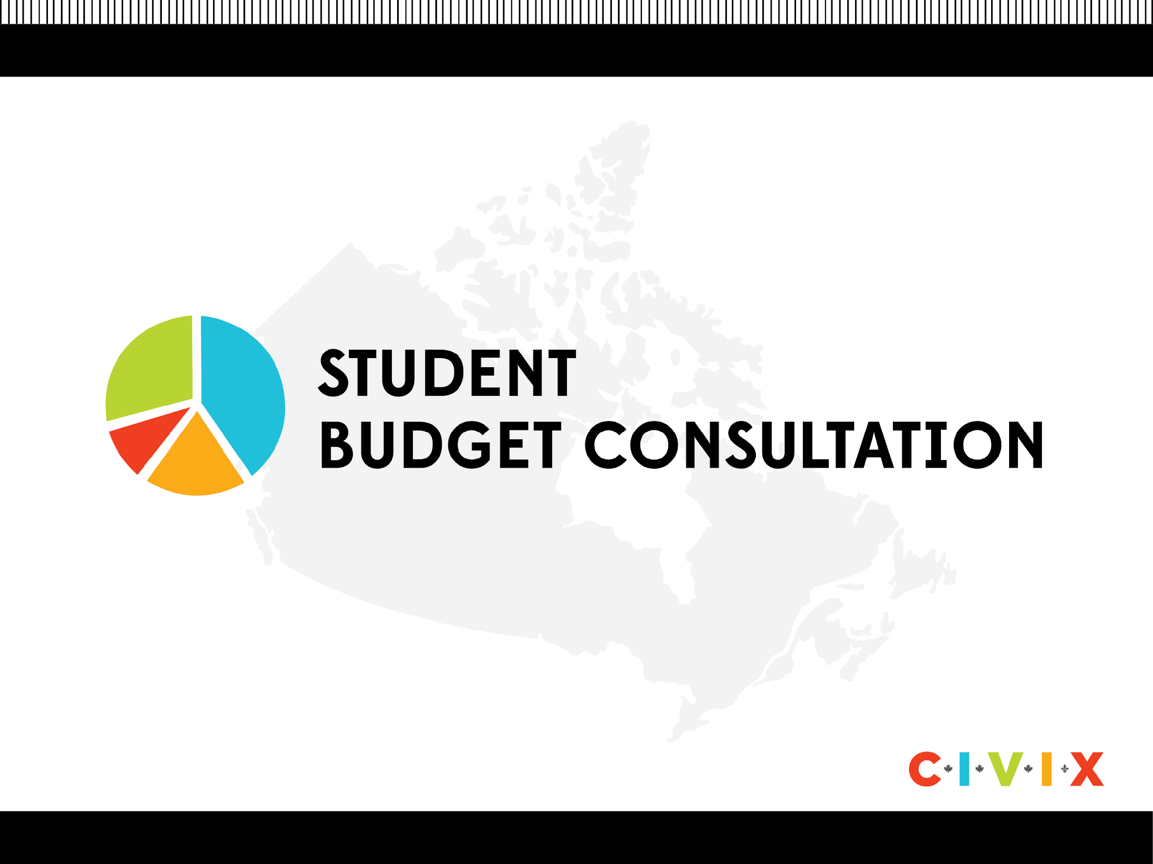
Slide Deck E: The Political Spectrum
Notes:
‹#›

Slide 2
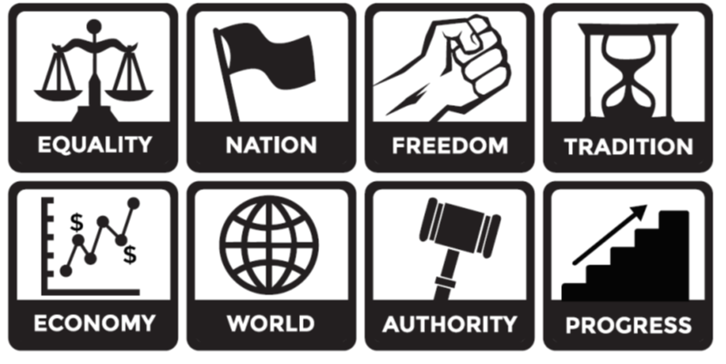
What is a political ideology?
A political ideology is a set of beliefs about how the government should work and how society should be organized. Different people have different beliefs, so there are several types of ideologies.

Slide 3

What is the political spectrum?
The political spectrum provides a way to characterize different views and beliefs, and to distinguish between different political ideologies and actions on political issues.
A linear spectrum is represented as a horizontal line. People who represent different ends of the spectrum usually have opposing views on a range of issues.
LEFT
RIGHT

Slide 4

Multi-Dimensional Political Spectrum
When there is more than one axis, each represents a different political dimension or set of issues.
Social Issues (vertical axis)
Economic Issues (horizontal axis)

Slide 5
Mini-Debate
Which do you think is better and why?
  Lower taxes, smaller government and less government services
  Higher taxes, larger government and more government services

Slide 6
Economic Dimension Overview
Left-leaning
Right-leaning
Higher taxes
Larger government
More government services
More government intervention in the economy
Lower taxes
Smaller government
Less government services
Less government intervention in the economy

Slide 7
Left-leaning Canadians (Economic Issues)
People who are left-leaning often believe that...
The government should help manage the economy and create jobs, not just leave it to businesses.
The gap between rich and poor (inequality) should be as small as possible.
Wealthier people and companies should pay more taxes than those with less money.
Government services like education and healthcare are important, even if it means higher taxes or debt to support them.
Rules and policies that might be hard for businesses but help solve social or environmental problems are important for everyone’s benefit.

Slide 8
Right-leaning Canadians (Economic Issues)
People who are right-leaning often believe that…
The government should not interfere much in the economy and should focus on supporting businesses and individuals to create jobs, wealth, and innovation.
It’s not fair to tax people more for earning more money. Their financial success is a reward for their contributions to society.
A smaller government with less influence on the economy and fewer services is better.
Taxes should be kept low, and the government should avoid going into debt unless absolutely necessary.
Businesses don’t need strict rules because the free market encourages them to take care of social and environmental issues on their own.

Slide 9
Towards the Centre
If you are at one end of the spectrum, you might feel very strongly about certain beliefs.
But what if you agree with some ideas but not all?
Or maybe you don’t feel as strongly about these issues as others do?
This is very common!
That’s why there are other positions, like centre-left and centre-right.
People closer to the centre might feel less strongly about some issues or only agree with certain views.

