Slide 1
Slide Deck B: The Government of Canada’s Expenditures

Slide 2




What is the government’s largest expenditure category?
Transfer payments
Interest on the debt
Program expenses
Taxes

Slide 3

What is the government’s largest expenditure category?
Transfer payments
Interest on the debt
Program expenses
Taxes

Slide 4
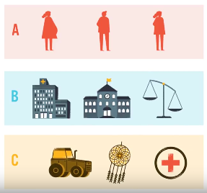
Transfers
Transfer payments are the government’s largest spending category.
Transfers are payments that go directly to:
Persons
Provincial and territorial governments
Organizations

Slide 5
Which people receive transfer payments from the government?
Seniors
Unemployed Canadians
Families
All of the above

Slide 6
Which people receive transfer payments from the government?
Seniors
Unemployed Canadians
Families
All of the above

Slide 7

Transfers to Persons
Elderly benefits, like Old Age Security (OAS) and the Guaranteed Income Supplement (GIS), which help seniors living on lower incomes.
Employment Insurance (EI) benefits, which help Canadians who are looking for work or are unable to work, such as persons who are injured or on parental leave.
Children’s benefits, which help families with young children and teens, such as the Canada Child Benefit (CCB).

Slide 8
Which is not the name of a transfer payment received by the provinces and territories?
Canada Health Transfer
Equalization payments
Canada Arts and Culture Transfer
Canada Social Transfer

Slide 9
Which is not the name of a transfer payment received by the provinces and territories?
Canada Health Transfer
Equalization payments
Canada Arts and Culture Transfer
Canada Social Transfer

Slide 10

Transfers to Provinces/Territories
These transfers support the delivery of provincial and territorial government programs.
The Canada Health Transfer, which provides long-term funding for health programs.
The Canada Social Transfer, which supports post-secondary education, social programs and services for children.
c) Equalization and Territorial Formula Financing programs, which address economic imbalances across the country so all Canadians can receive comparable public services.

Slide 11
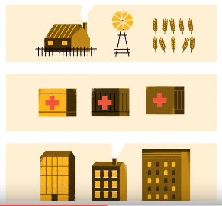

“Other Transfers”
The final group of transfers goes to organizations through federal grants, contributions and subsidies.
Farmers and food producers
Foreign aid/international assistance
Infrastructure/regional development
First Nations and Indigenous peoples
Research and development
Assistance to businesses
Student assistance programs
Health research and promotion
The arts and amateur sports
Multiculturalism and bilingualism

Slide 12
How many federal departments and agencies are there currently?
67
112
214
338

Slide 13
How many federal departments and agencies are there currently?
67
112
214
338

Slide 14





Program Expenses
These include the operating costs of the more than 200 federal bodies, including departments, agencies, and crown corporations that provide programs and services.

Slide 15
A fee that must be paid on money borrowed is called…
Debt tax
Interest
Debt repayment
Tariff

Slide 16
A fee that must be paid on money borrowed is called…
Debt tax
Interest
Debt repayment
Tariff

Slide 17
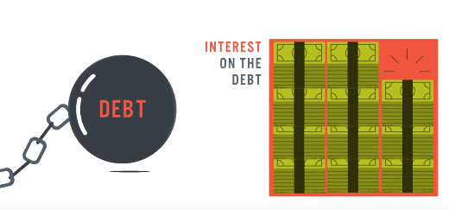
Interest Payments
The final spending area is interest on the debt.
The Government pays interest charges on the money borrowed over the years and not yet repaid.

Slide 18
Breakdown of Major Expenditures
 |  | 2023-24 | 2024-25
Major Transfers to Persons | Employment Insurance benefits | 24.2 | 26.5
 | Canada Child Benefit | 25.6 | 27.3
 | Elderly Benefits | 75.9 | 80.6
Major Transfers to Other Levels of Government | Canada Health Transfer | 49.4 | 52.1
 | Equalization | 24.0 | 25.2
 | Canada Social Transfer | 16.4 | 16.9
 | Canada-Wide Early Learning and Child Care | 6.6 | 7.2
Program Expenses | Other transfer payments | 86.4 | 92.8
 | Operating expenses | 123.7 | 123.1
Other Expenses | Public debt charges | 43.9 | 46.5
Total Expenditures |  | 496.9 | 498.2
*Amounts are in billions of dollars; chart shows main expenses only–numbers do not add up to total

Slide 19
Discussion
What have you learned about the Government of Canada’s expenditures?
Are any expenditure amounts more than you expected?
Are any expenditure amounts less than you expected?
How does this influence your thinking about the federal budget?

