Slide 1
Slide Deck A: Budget Basics Trivia

Slide 2

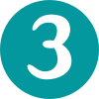

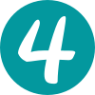
How many levels of government are there in Canada?
2
5
3
6

Slide 3

How many levels of government are there in Canada?
2
5
3
6

Slide 4

Levels of Government
Canada has three main levels of government. Each has its own elected representatives and areas of responsibility.
Federal
Provincial/Territorial
Municipal/Local
Many First Nations, Inuit, and Métis communities also have their own systems of governance and share certain responsibilities with different levels.
The levels of government work together on many issues, such as the environment.

Slide 5
Which of the following is not a responsibility of the federal government?
National defence
Immigration
International trade
Water supply

Slide 6
Which of the following is not a responsibility of the federal government?
National defence
Immigration
International trade
Water supply

Slide 7
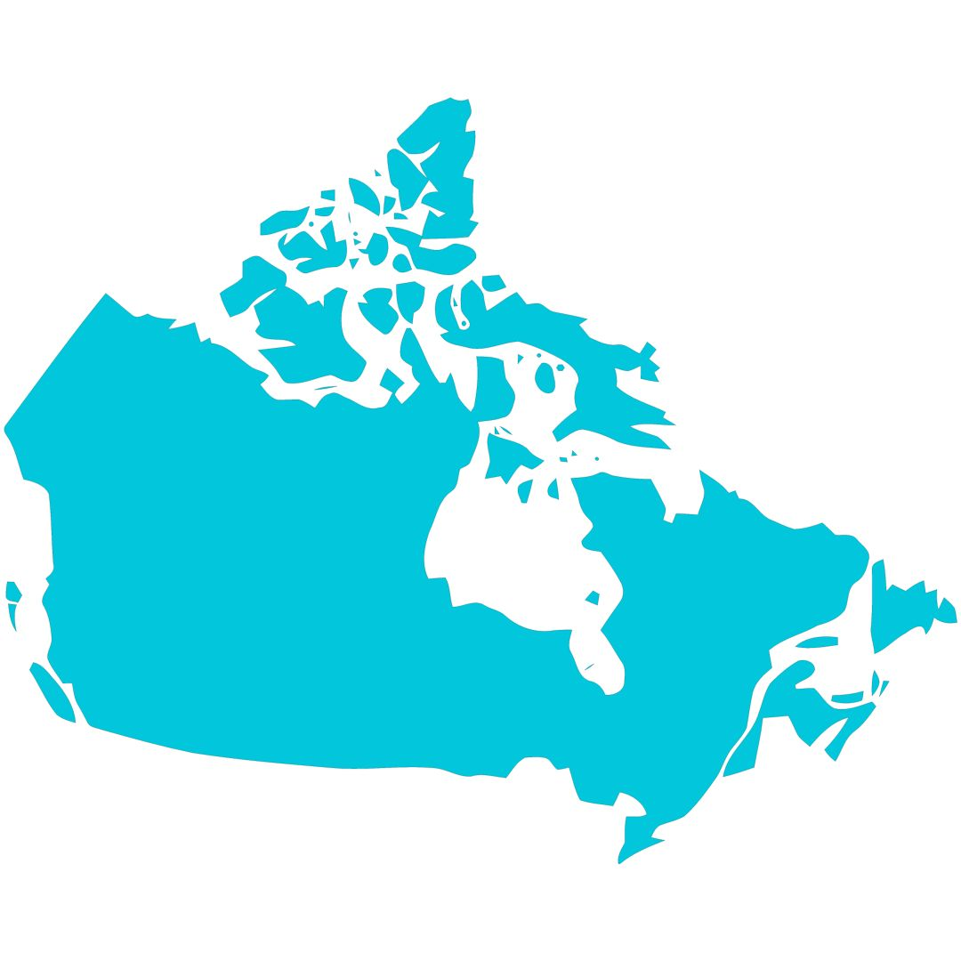
Federal
The federal government is responsible for all national matters and concerns.
For example:
  National defence/armed forces
  Public safety
  Foreign affairs
  International trade
  Citizenship and immigration
  Fisheries and oceans

Slide 8
The amount of money that the federal government spends on programs and services is called its: ________________.
Revenues
Surplus
Expenditures
Finances

Slide 9
The amount of money that the federal government spends on programs and services is called its: ________________.
Revenues
Surplus
Expenditures
Finances

Slide 10
Expenditures refers to payment for goods and services.
It represents an outflow of money.
In comparison, revenue refers to money received or earned.
It represents incoming money.

Slide 11
A deficit happens when…
You have more expenditures than revenue.
You have the same amount of revenue and expenditures.
You have more revenue than expenditures.
You do not have any revenue or expenditures.

Slide 12
A deficit happens when…
You have more expenditures than revenue.
You have the same amount of revenue and expenditures.
You have more revenue than expenditures.
You do not have any revenue or expenditures.

Slide 13


A deficit happens when you have more expenditures than revenue, or when you spend more than you earn.
A surplus occurs when you have more revenue than expenditures, or when you earn more than you spend.
When you have an equal amount of revenue and expenditures, you have a balanced budget.

Slide 14
Money that is borrowed and has not been paid back is called…
Savings
Reserves
Debt
Income

Slide 15
Money that is borrowed and has not been paid back is called…
Savings
Reserves
Debt
Income

Slide 16
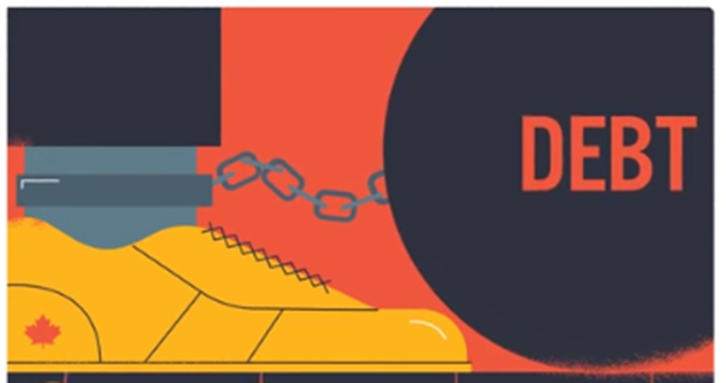
When you have a deficit, you need to borrow money to cover the shortfall or gap.
The money you borrow becomes your debt. Your debt is the accumulation of deficits.

Slide 17
The government’s annual budget covers what time period?
January 1 to December 31
September 1 to June 30
September 1 to August 31
April 1 to March 31

Slide 18
The government’s annual budget covers what time period?
January 1 to December 31
September 1 to June 30
September 1 to August 31
April 1 to March 31

Slide 19
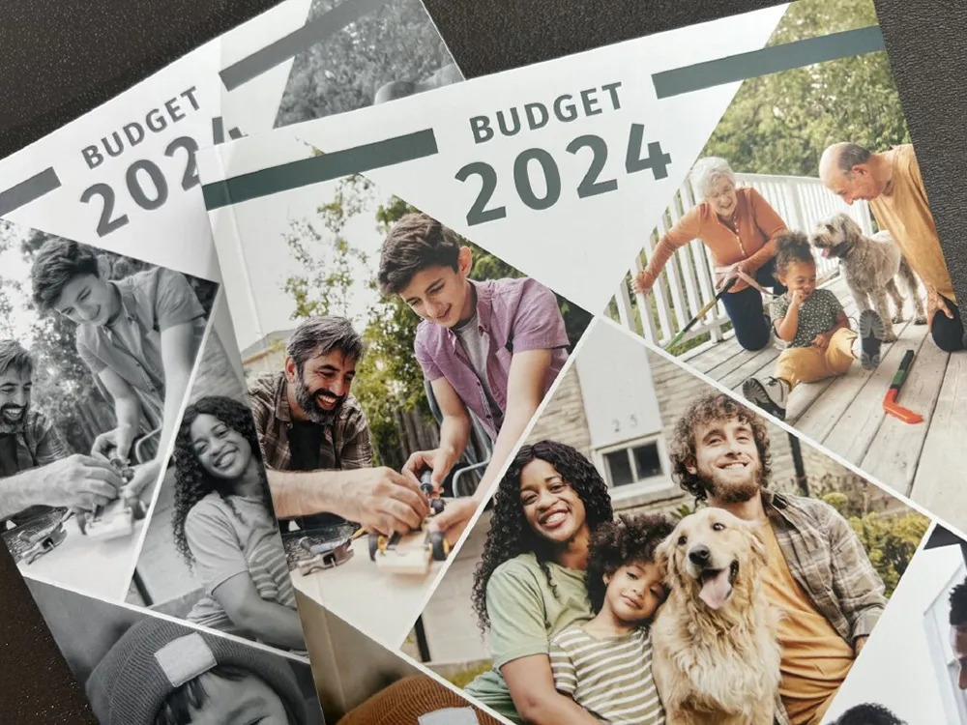
The Federal Government’s Budget
The government’s fiscal year runs from April 1 to March 31. Each annual budget forecasts revenue and expenditures for this period.
Budget 2025 will estimate revenues and expenditures for the next fiscal period (April 1, 2025 to March 31, 2026). It will likely be released in March or April 2025.

