Slide 1
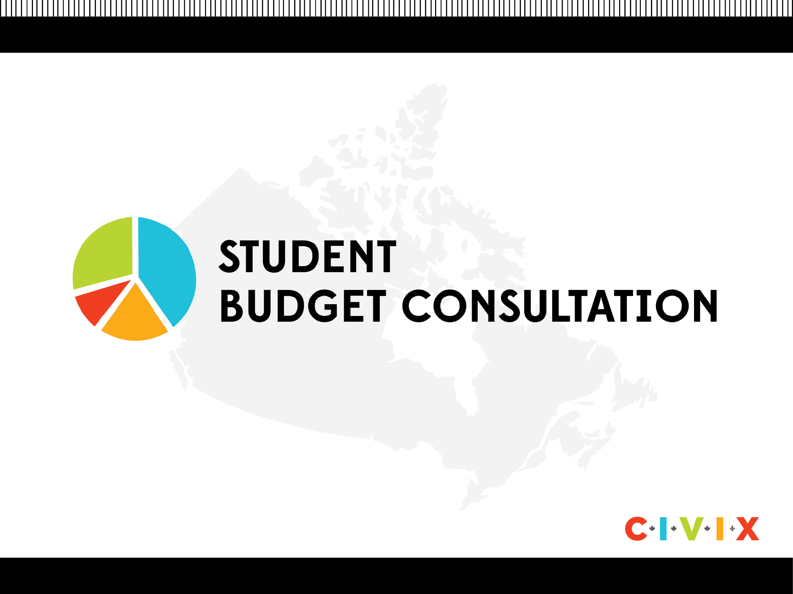
Slide Deck C: The Government of Canada’s Revenues

Slide 2




Money that the government collects or earns is called…
Profit
Interest
Savings
Revenue

Slide 3

Money that the government collects or earns is called…
Profit
Interest
Savings
Revenue

Slide 4
The largest source of government revenue is:
Crown earnings
Taxes
Employment insurance premiums
International trade
Notes:
Crown earnings are profits from the sale of goods and services by Crown Corporations (businesses established by the federal government, e.g., Canada Post, VIA Rail).

Slide 5
The largest source of government revenue is:
Crown earnings
Taxes
Employment insurance premiums
International trade
Notes:
Crown earnings are profits from the sale of goods and services by Crown Corporations (businesses established by the federal government, e.g., Canada Post, VIA Rail).

Slide 6
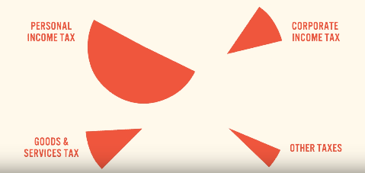
Taxes
Taxes are a sum of money charged by the government to individuals and businesses. They represent roughly 80 per cent of the federal government’s revenues.
There are four main tax categories:
Personal income tax
Corporate income tax
Goods & services tax
Other taxes

Slide 7
Canadians pay tax on the money they earn.
How much money can you earn each year before needing to pay taxes?
$1,000
$6,787
$13,808
$15,000
Notes:
Crown earnings are profits from the sale of goods and services by Crown Corporations (businesses established by the federal government, e.g., Canada Post, VIA Rail).

Slide 8
Canadians pay tax on the money they earn.
How much money can you earn each year before needing to pay taxes?
$1,000
$6,787
$13,808
$15,000
Notes:
Crown earnings are profits from the sale of goods and services by Crown Corporations (businesses established by the federal government, e.g., Canada Post, VIA Rail).

Slide 9
Personal Income Tax
Personal Income Tax is the money collected from individuals based on the money they earn through a job and other investments.
The amount you pay depends on how much you earn. At the federal level, here are some approximate levels:
  0% on the first $13,808 of income
  15% on the next $35,212 of taxable income (portion over $13,808 up to $49,020)
  20.5% on the next $49,020 of taxable income (portion over $49,020 up to $98,040)
  26% on the next $ 53,939 of taxable income (portion over $98,040 up to $151,978)
  29% on the next $64,533 of taxable income (portion over $ 151,978 up to $216,511)
  33% of taxable income over $216,511
  Note: Provinces/Territories also have their own income tax rates, ranging from 4-21%.
Notes:
https://www.canada.ca/en/revenue-agency/services/tax/individuals/frequently-asked-questions-individuals/canadian-income-tax-rates-individuals-current-previous-years.html

Slide 10
Personal Income Example
Samira works as a graphic designer at a web development firm. She earns $60,000 per year.
The table below shows how her federal income tax is calculated.
In addition, she would pay another amount for provincial income tax depending where she lived. If she lived in Ontario, it would be around $2,942.21. In Alberta it would be $4,063.10
Income | Tax Rate | Tax Amount
First $13,808 | 0.0% | $0.00
Next $35,212 | 15.0% | $5,281.80
Next $10,980 | 20.5% | $2,250.9
Total income: $60,000 |  | Total taxes: $7,532.7

Slide 11
Businesses have to pay a tax on their profits every year.
What is the tax rate for businesses at the federal level?
40%
15%
25%
8%

Slide 12
Businesses have to pay a tax on their profits every year.
What is the tax rate for businesses at the federal level?
40%
15%
25%
8%

Slide 13
Corporate Income Tax
Businesses, or corporations, pay tax on their net profits (their revenue minus expenses).
The general corporate tax rate is 15% and has remained the same since 2012.
The small business corporate tax rate is 9% (down from 11% in 2015).
Just like personal income tax, businesses must also pay a provincial corporate tax rate.

Slide 14
The federal tax on goods and services (GST) bought in Canada is currently…
14%
5%
22%
8%

Slide 15
The federal tax on goods and services (GST) bought in Canada is currently…
14%
5%
22%
8%

Slide 16
Goods and Services Tax
The Goods and Services Tax (GST) is applied to most purchases you make, such as clothes, toys and video games. The current GST rate is 5%.
For example: $100 video game x 5% GST = $5
Total = $105.00
Some provinces charge their own provincial sales tax (PST), or have a Harmonized Sales Tax (HST). The HST includes both the GST and the PST.
For example: $100 video game x 13% HST ($5 GST + $8 PST) = $13
Total = $113.00

Slide 17
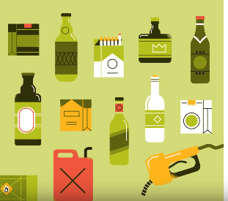
Other Taxes
There are a number of other taxes, such as non-resident withholding taxes, import duties, energy taxes, levies on products manufactured or produced in Canada, and duties on alcohol and tobacco.

Slide 18
Who pays Employment Insurance premiums?
Employers and employees
Employers only
Employees only
People who are unemployed

Slide 19
Who pays Employment Insurance premiums?
Employers and employees
Employers only
Employees only
People who are unemployed

Slide 20

EI Premiums
The federal government collects Employment Insurance (EI) premiums from employers and employees to help pay for Employment Insurance benefits.
Employment Insurance benefits help people who are looking for work or who are unable to work (due to injury or parental leave).

Slide 21
Which of the following is not a crown corporation?
CBC – Radio Canada
Canada Post
Bank of Canada
Canadian Tire

Slide 22

Which of the following is not a crown corporation?
CBC – Radio Canada
Canada Post
Bank of Canada
Canadian Tire

Slide 23
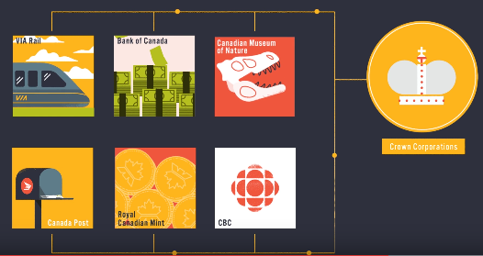
Crown Corporations
Crown Corporations are businesses established by the federal government that generate revenue from the sale of goods and services.

Slide 24
Breakdown of Revenues
 | 2022-23 | 2023-24
EI Premiums | 26.8 | 28.2
GST | 45.4 | 51.4
Other taxes and duties | 17.8 | 19.3
Non-resident income tax | 13.6 | 13.7
Corporate income tax | 88.0 | 85.5
Personal income tax | 206.8 | 213.7
Crown Corporations | 5.9 | 5.6
Other | 33.0 | 39.4
Total Revenues | 437.3 | 456.8
*Amounts are in billions of dollars

Slide 25
Discussion
What have you learned about the Government of Canada’s revenues?
Do any revenue sources bring in more money you expected?
Do any revenue sources bring in less money you expected?
How does this influence your thinking about the federal budget?

